Slide 1
Infrastructure as a Service
Lecturer: Ngo Huy Bien
Software Engineering Department
Faculty of Information Technology
University of Science
Ho Chi Minh City, Vietnam
nhbien@fit.hcmus.edu.vn

Slide 2

Objectives

Slide 3

Contents

Slide 4

References
Rajkumar Buyya (2011). Cloud Computing - Principles and Paradigms. Wiley.
Gautam Shroff (2010). Enterprise Cloud Computing. Cambridge University Press.
Paul Barham et al. (2003). Xen and the Art of Virtualization.
Jeremy Sugerman et al. (2002). Virtualizing IO Devices on VMware Workstation's Hosted Virtual Machine Monitor.
John Fisher-Ogden (2006). Hardware Support for Efficient Virtualization.
Keiko Hashizume et al. (2012). Cloud Service Model Patterns.
Antonio Celesti et al. (2010). How to Enhance Cloud Architectures to Enable Cross-Federation.

Slide 5
Public Clouds
Lab 01 details.
OS Organization and System Calls (see OS >> "03. OS Organization and System Calls.pptx")
Virtual Machines (see OS >> "11. Virtual Machines.pptx")
AWS Nitro System (see "03.1.8. AWS Nitro System.pptx")
Software-Defined Networking (see "03.6. Software-Defined Networking.pptx")

Slide 6
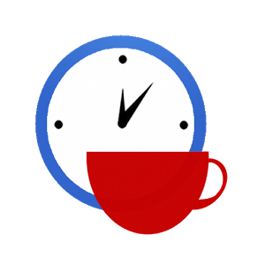

Slide 7
Virtualization [1]
Virtualization can be defined as the abstraction of the four computing resources (storage, processing power, memory, and network or I/O).
It is conceptually similar to emulation, where a system pretends to be another system, whereas virtualization is a system pretending to be two or more of the same system.

Slide 8
Virtual Machine Monitors [2]
Many system virtual machine (VM) instances share the same physical hardware through a virtual machine monitor (VMM), also commonly referred to as a hypervisor.
A host VMM is implemented as a process running on a host operating system that has been installed on the machine in the normal manner.
A native VMM, on the other hand, does not require a host operating system, and runs directly on the physical machine.

Slide 9
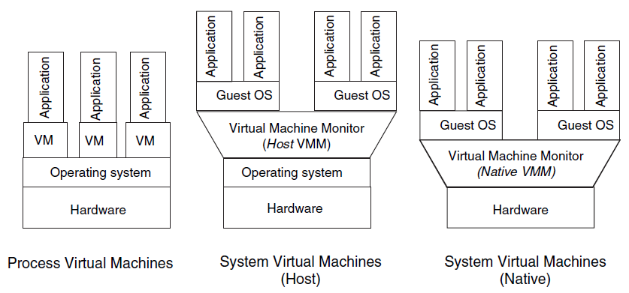
Virtual Machines
Virtual machine which itself runs as an operating system process but provides a system-independent abstraction of the machine to an application is called process virtual machine.

Slide 10
Virtualization Standardization [1]
Distributed Management Task Force (DMTF) have produced standards for almost all the aspects of virtualization technology.
Virtualization Management Initiative (VMAN) delivers broadly supported interoperability and portability standards for managing the virtual computing lifecycle.
VMAN’s Open Virtualization Format (OVF) is a collaboration between industry key players: Dell, HP, IBM, Microsoft, XenSource, and Vmware.
OVF specification provides a common format to package and securely distribute virtual appliances across multiple virtualization platforms.

Slide 12
Why Virtualization? [3]
server consolidation
co-located hosting facilities
organizations place (co-locate) their own servers and networking equipment inside a shared, professionally managed facility.
distributed web services
secure computing platforms
application mobility

Slide 13
Goal and Approach
Goal: Host multiple applications and servers on a shared machine.
Approach: Retrofit support for performance isolation to the operating system.
Multiplex physical resources at the granularity of an entire operating system.
Difficulty: Ensure that all resource usage is accounted to the correct process.

Slide 14
Domain
Note that in this paper we reserve the term guest operating system to refer to one of the OSes that Xen can host and we use the term domain to refer to a running virtual machine within which a guest OS executes;
the distinction is analogous to that between a program and a process in a conventional system.
We call Xen itself the hypervisor since it operates at a higher privilege level than the supervisor code of the guest operating systems that it hosts.

Slide 15
The Virtual Machine Interface
Memory management
CPU
Device I/O

Slide 16
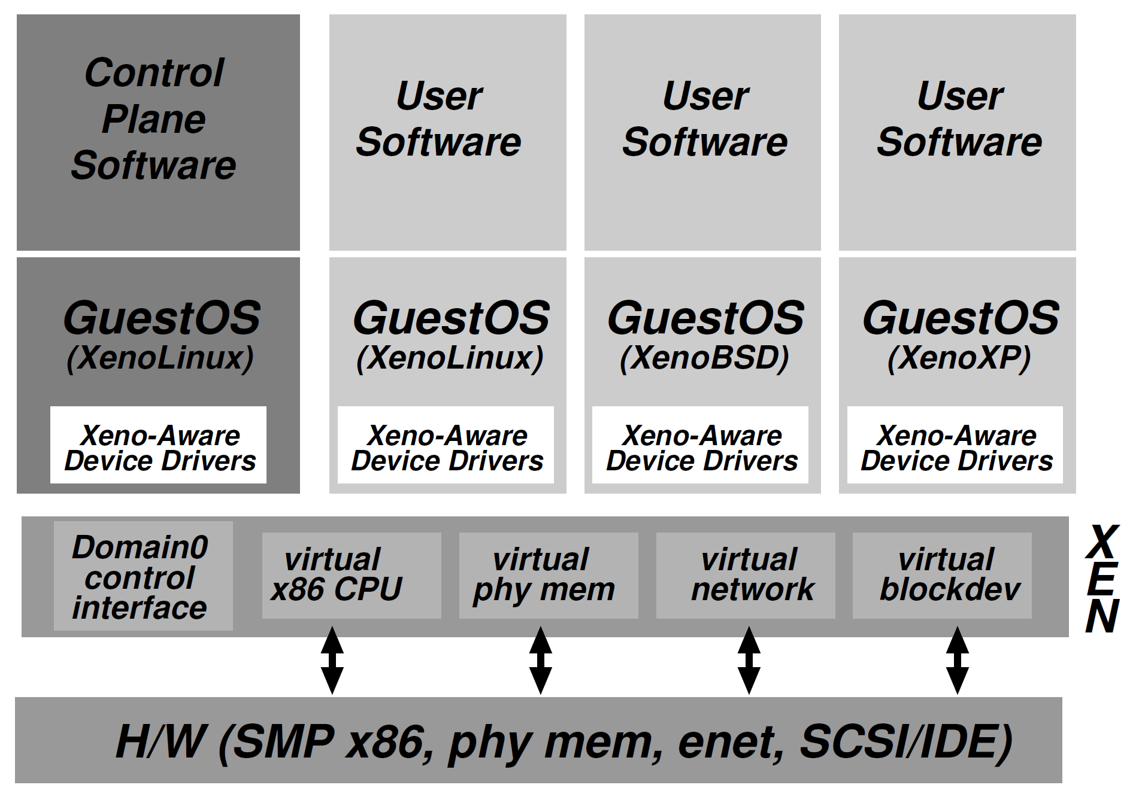
Xen Architecture

Slide 17
Domain0
a domain is created at boot time which is permitted to use the control interface.
This initial domain, termed Domain0, is responsible for hosting the application-level management software.
The control interface provides the ability to create and terminate other domains and to control their associated scheduling arameters, physical memory allocations and the access they are given to the machine's physical disks and network devices.

Slide 19
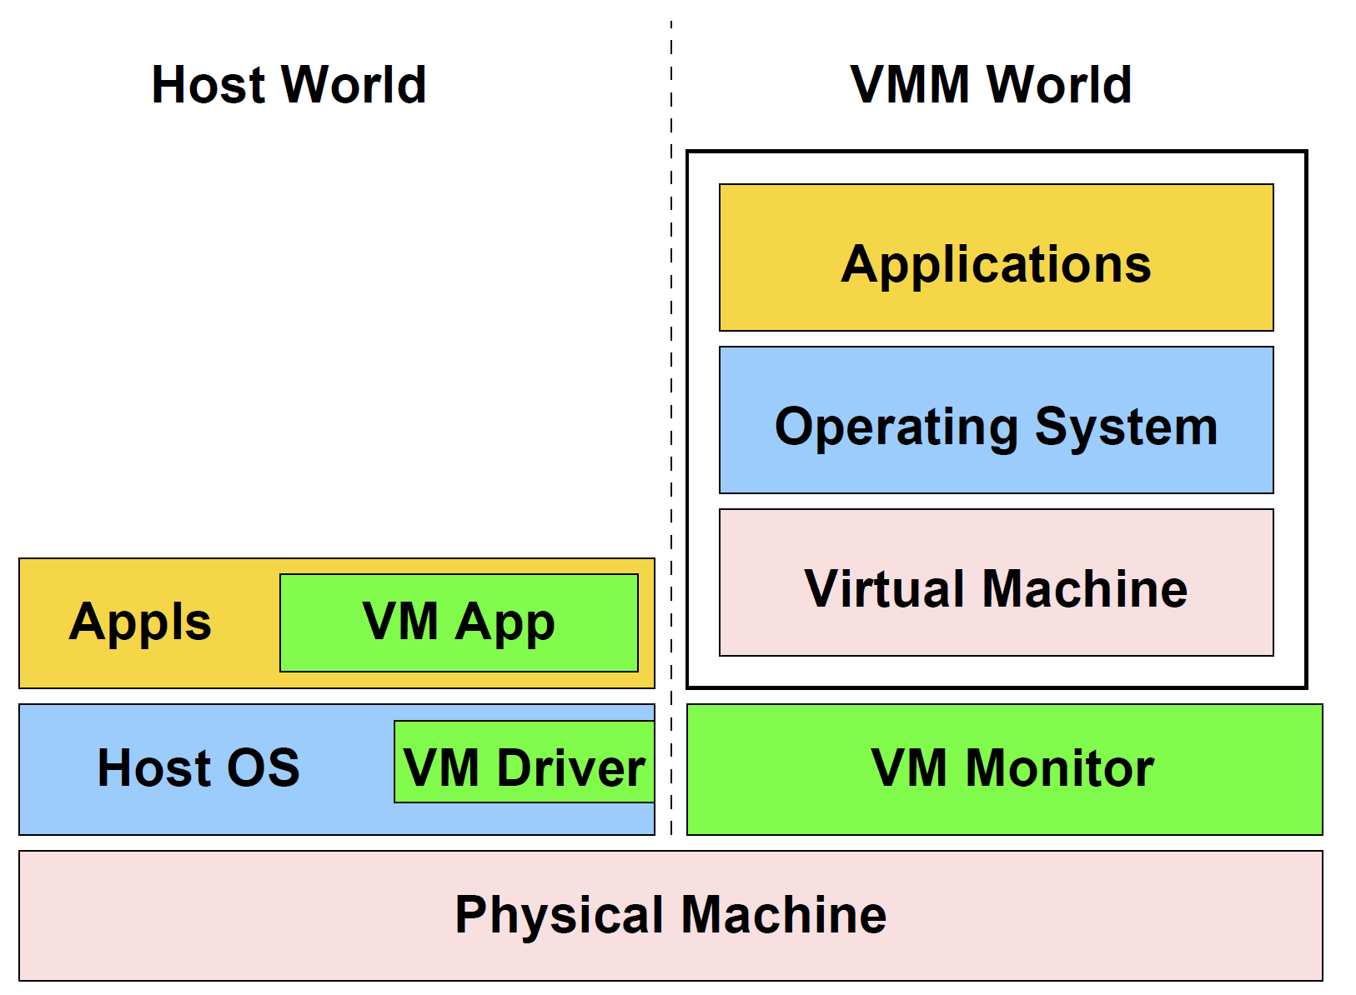
VMware Workstation [4]

Slide 20
VMware Workstation Details
VMware Workstation installs like a normal application on an operating system, known as the host operating system.
When run, the application portion (VMApp) uses a driver loaded into the host operating system (VMDriver) to establish the privileged virtual machine monitor component (VMM) that runs directly on the hardware.
From then on, a given physical processor is executing either the host world or the VMM world, with the VMDriver facilitating the transfer of control between the two worlds.
A world switch between the VMM and the host worlds involves saving and restoring all user and system visible state on the CPU, and is thus more heavyweight than a normal process switch.

Slide 21
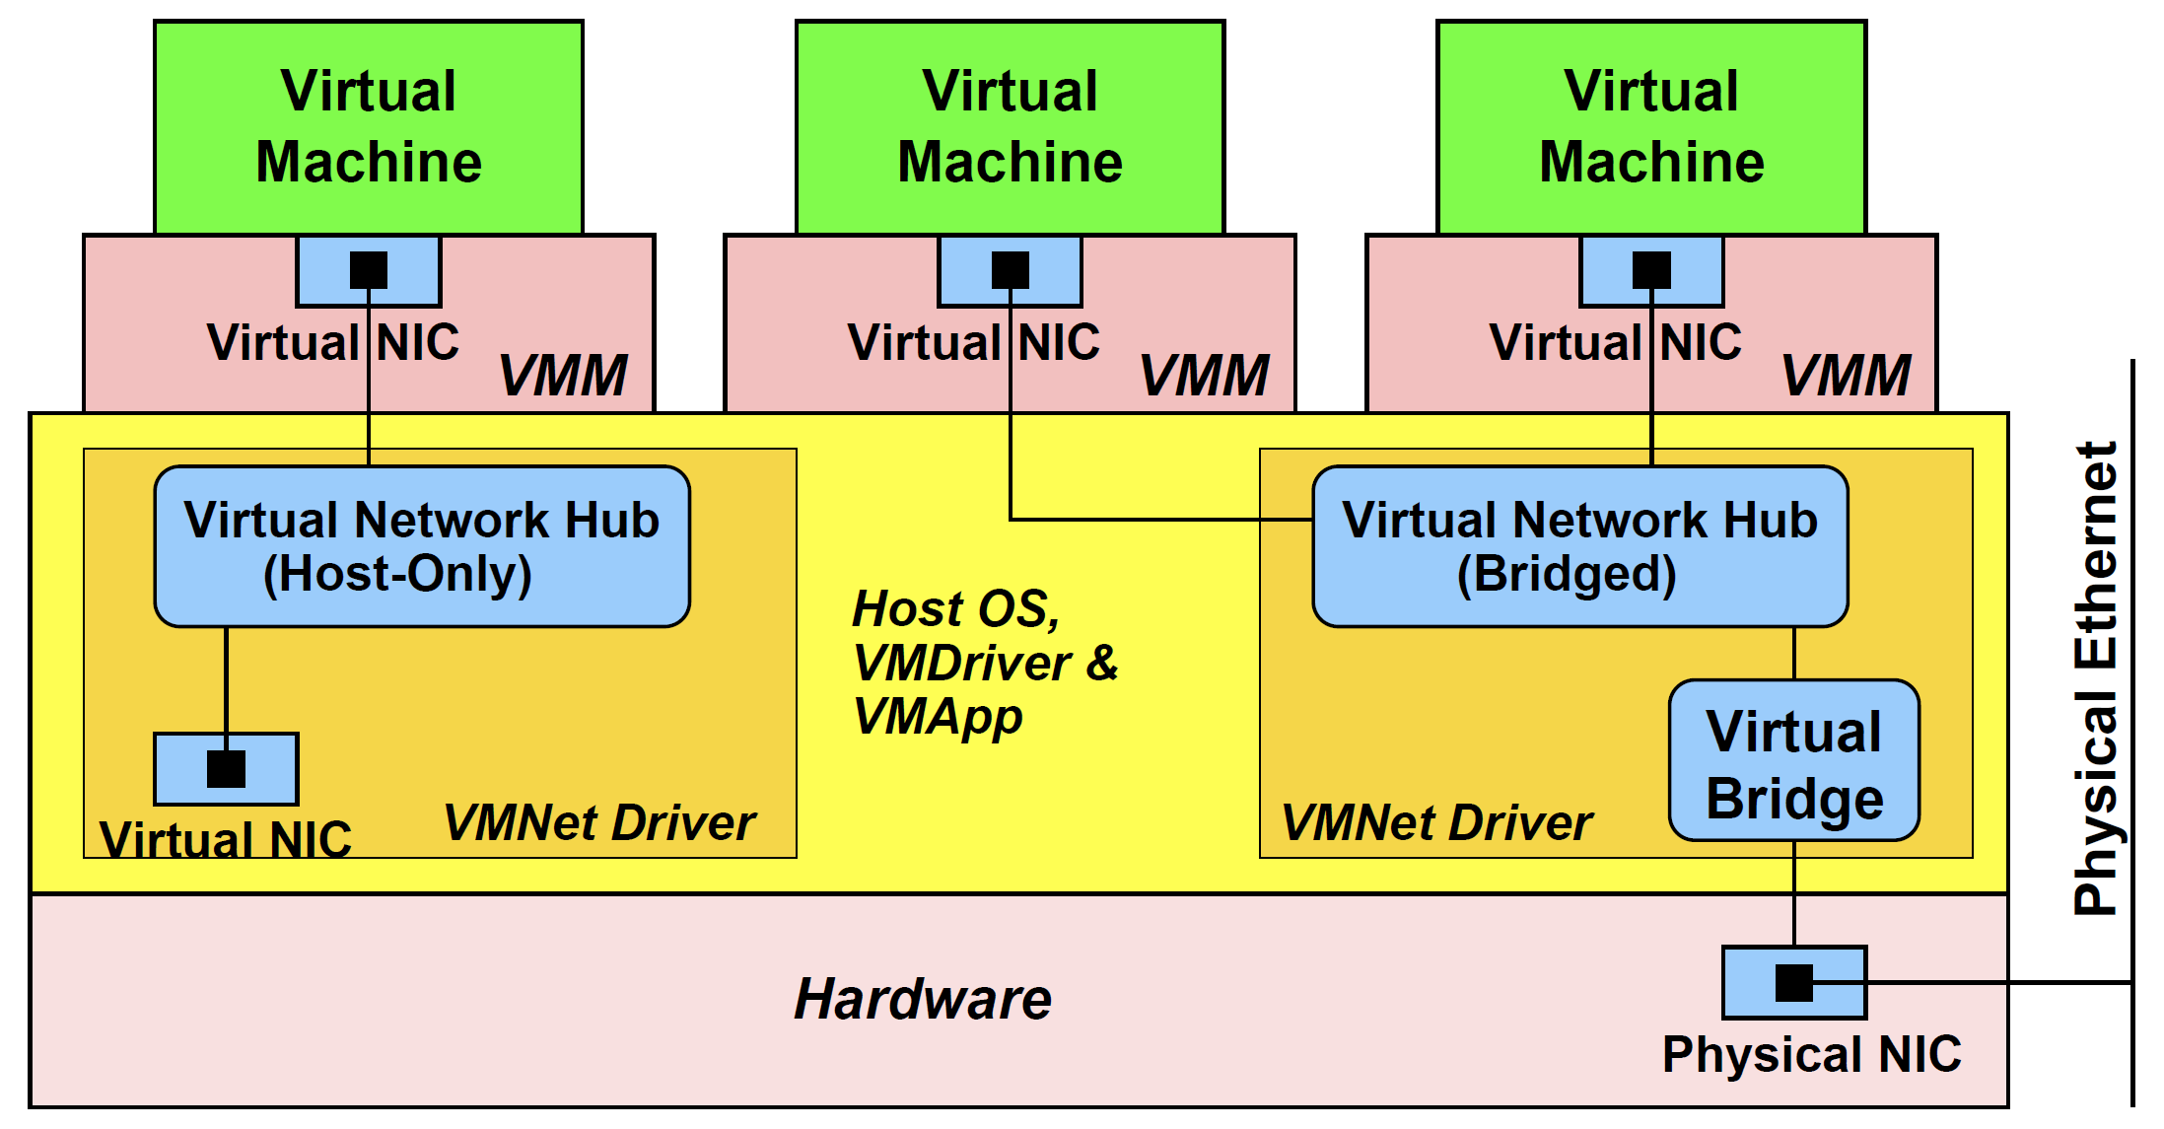
Virtualizing a Network Card

Slide 22
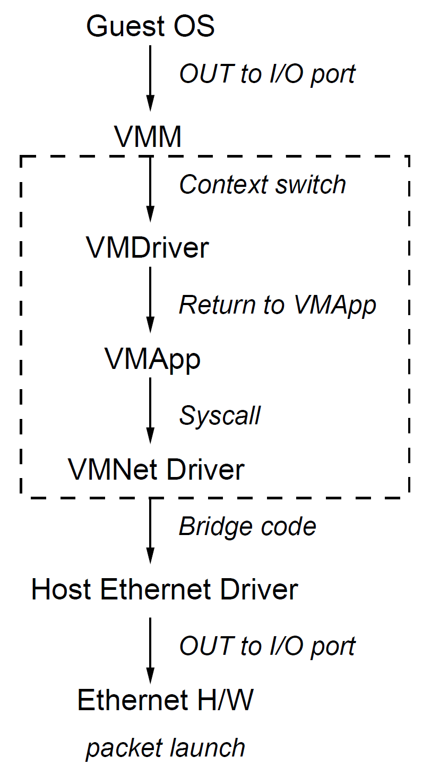
Network Packet Send

Slide 24
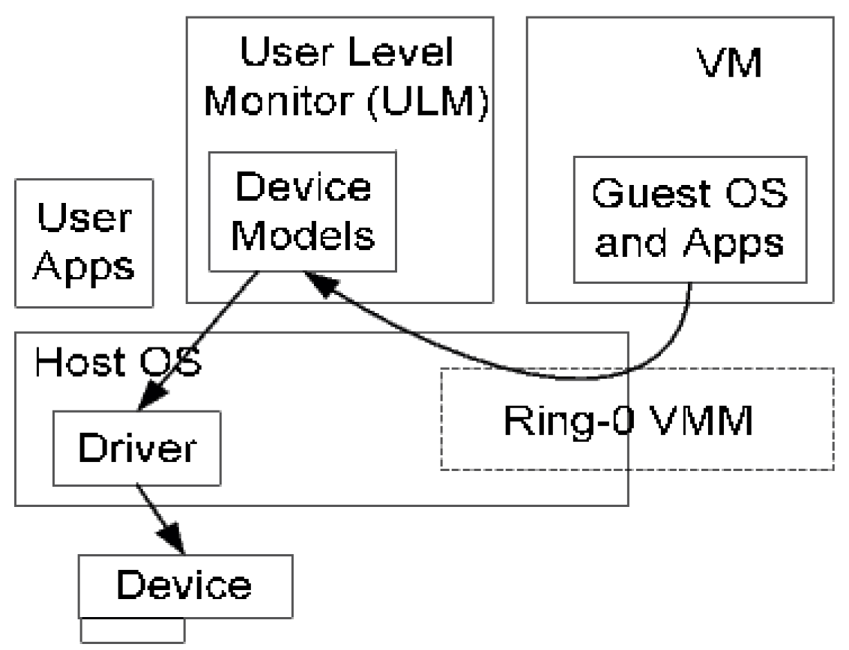
Hosted VMMs [5]
The VMM executes in an existing OS, utilizing the device drivers and system support provided by the OS.

Slide 25
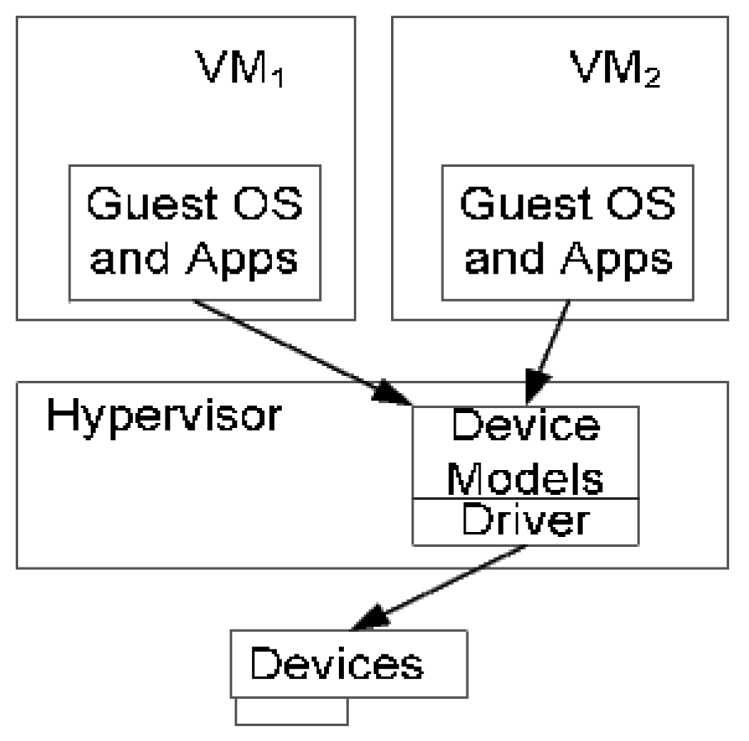
Stand-Alone VMMs
A hypervisor runs directly on the hardware and incorporates its own drivers and system services.

Slide 26
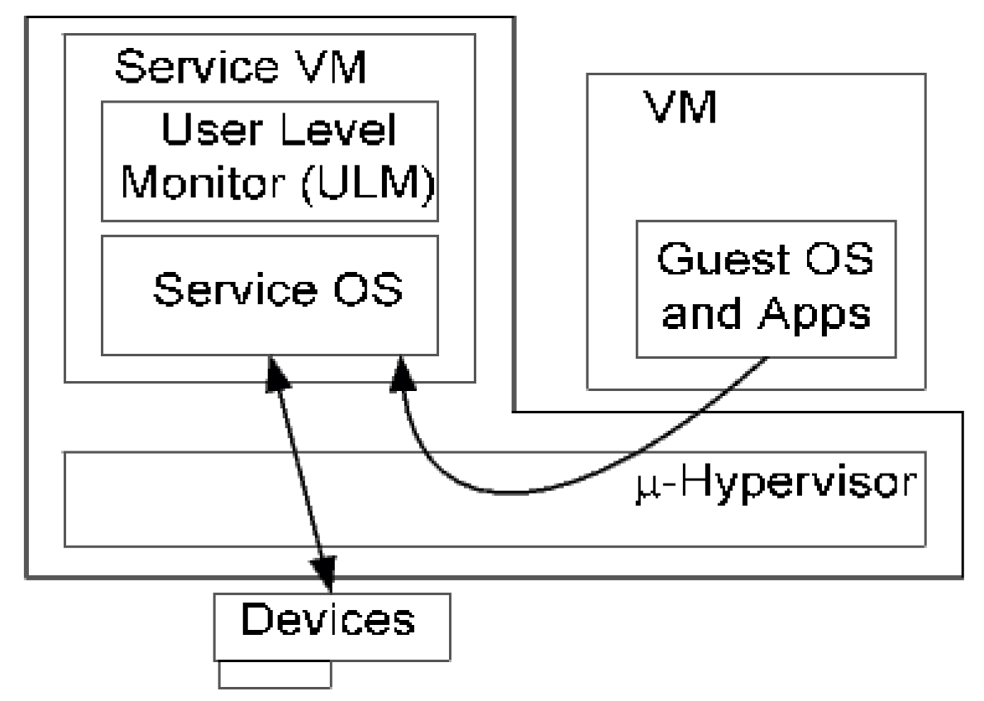
Hybrid VMMs
Combines the control of a standalone VMM with the simplicity of hosted VMM by running a deprivileged service OS as an additional guest and routing I/O requests through it.

Slide 28
Private Clouds (I)
Lab 02 details
Physical LAN: Machines, MAC Addresses, Switches, IP Addresses, Routers. (See Computer Networks >> "04. The Data Link Layer.pptx")
Physical WAN, ISP, Internet, Network Software (Applications, Sockets, TCP, UDP, ARP, IP, Drivers, NICs). (See Computer Networks >> "08. Networking Software.pptx")
VPN (See Computer Networks >> "05. The Network Layer.pptx")

Slide 29
Private Clouds (II)
VMs, VM virtual NICs, MAC Addresses, IP Addresses (The hypervisor provides all of them.)
vSwitches, vLANs (The hypervisor provides all of them.)
Hypervisor physical network cards.
Datacenter networks: servers, racks, switches, routers.
VPS.

Slide 30
Private Clouds (III)
Virtual distributed switches: vCenter.
Virtual routers: VMware NSX.

Slide 31
Virtualization Software
VmWare https://support.broadcom.com/group/ecx/free-downloads (search for "workstation" or "fusion" and "vSphere", see https://knowledge.broadcom.com/external/article/387785/download-vcenter-server-patches-and-isos.html)
Proxmox Virtual Environment https://www.proxmox.com/en/proxmox-ve
OpenNebula https://opennebula.io/
Nimbus https://www.nimbusproject.org/
Eucalyptus https://www.eucalyptus.cloud/
Xen https://xenproject.org/users/virtualization/
KVM https://www.linux-kvm.org/page/Main_Page

Slide 33
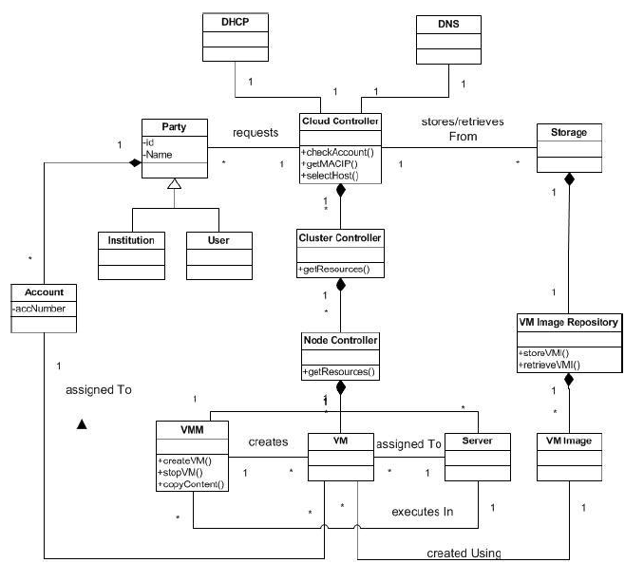
Cloud Infrastructure Pattern [6]

Slide 34
Cloud Infrastructure – Structure
A Party can be an institution or a user (customers and administrators). A Party can have one or more Accounts.
The Cloud Controller is the main component which processes requests from a Party.
When a Cloud Controller receives a request from the party to create a VM, it requests its corresponding Cluster Controllers to provide a list their free resources.
A Cluster Controller is composed of a collection of Node Controllers, which consist of a pool of Servers that host Virtual Machine (VM) instances.
A Node Controller controls the execution, monitoring, and termination of the VMs through a Virtual Machine Monitor (VMM) which is the one responsible to run VM instances.
The Cloud Controller retrieves and stores user data and Virtual Machine Images (VMI).
The Virtual Machine Image Repository contains a collection of Virtual Machine Images that are used to instantiate a VM.
The Dynamic Host Configuration Protocol (DHCP) server assigns a MAC/IP (Media Access Control/Internet Protocol) pair address for each VM through the Cloud Controller, and requests the Domain Name System (DNS) server to translate domain names into IP addresses in order to locate cloud resources.

Slide 36
Cross-Cloud Federation [7]
Motivation: How to enable cross-cloud federation?
Contributions:
The Cross-Cloud Federation Manager, a new component place-able inside the cloud architectures, allowing a cloud to establish the federation with other clouds according to a three-phase model: discovery, match-making and authentication.
The possible implementation practice of three agents has been presented, pointing out the technologies on which such implementation could rely.
Limitations: No evaluation (a simulated environment).

Slide 37
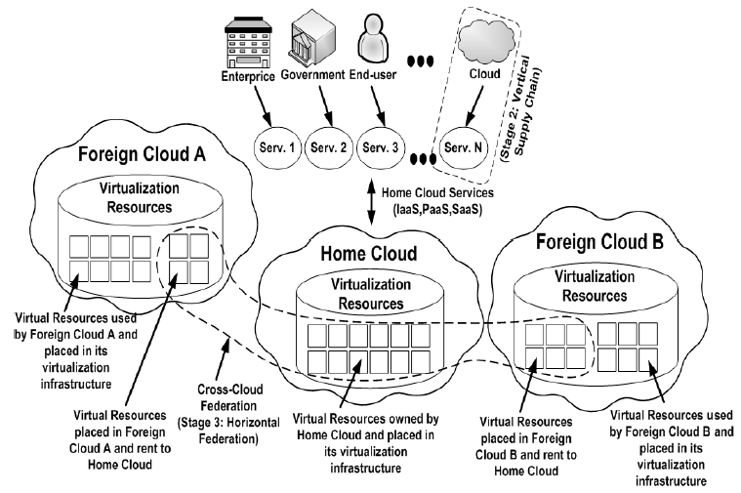
Cross-Cloud Scenario

Slide 38
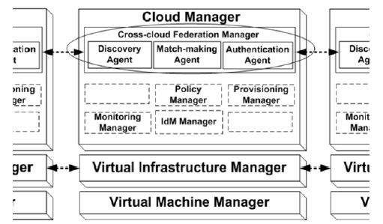
Cross-Cloud Federation Manager
The Discovery Agent: It manages the discovery process among all the available clouds within the dynamic environment.
The Match-Making Agent: It accomplishes the task of choosing the more convenient foreign cloud(s) wherewith to establish a cross-cloud federation.
The Authentication Agent: It, cooperating with third parties trusted entities, is responsible to create a security context between home and foreign clouds.

Slide 39
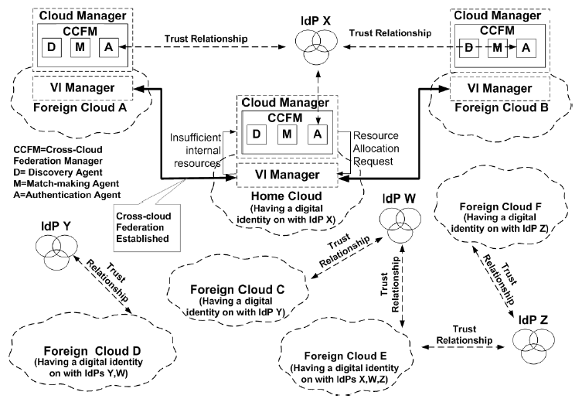
Cross-cloud Federation Establishment
IdP - the third party asserting to a foreign cloud the trustiness of the home cloud identity.

Slide 40

Further Reading

Slide 41

Thank You & See You Again

